Slide 1
BOOK CHAPTERS 24
ELECTRIC POTENTIAL
LESSON 5

Slide 2
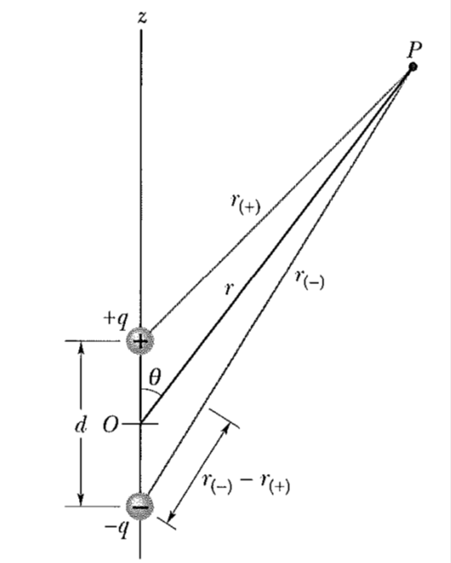
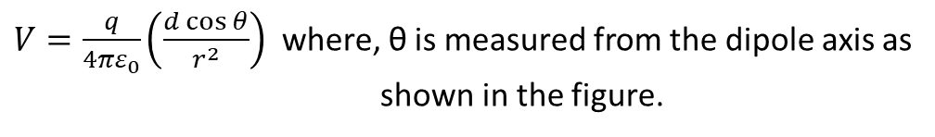

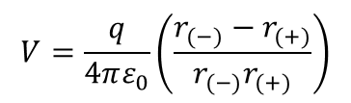
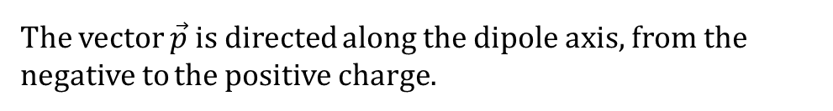
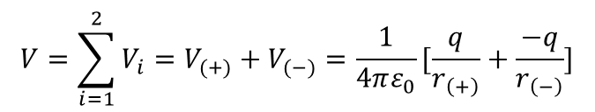
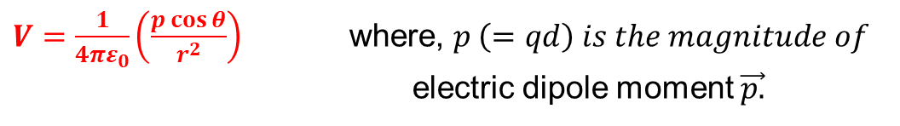
Potential Due to an Electric Dipole:
The net potential at P is given by
$$V=\sum_{i=1}^{2}{V_{i}=V_{(+)}+V_{(−)}=\frac{1}{4πε_{0}}[\frac{q}{r_{\left(+\right)}}+\frac{−q}{r_{\left(−\right)}}]}$$
$$V=\frac{q}{4πε_{0}}\left(\frac{r_{(−)}−r_{(+)}}{r_{(−)}r_{(+)}}\right)$$
For dipoles, usually, r $≫d$, where d is the distance between the charges.
Under the above condition, from the figure we can write
$$r_{(−)}−r_{\left(+\right)}=dcosθ and r_{\left(−\right)}r_{\left(+\right)}≈ r^{2}$$
Substituting these values in the above equation, we get
$V=\frac{q}{4πε_{0}}\left(\frac{d\cos{θ}}{r^{2}}\right)$ where, θ is measured from the dipole axis as
shown in the figure.
$V=\frac{1}{4πε_{0}}\left(\frac{p\cos{θ}}{r^{2}}\right)$ where, $p \left(=qd\right) is the magnitude of$
electric dipole moment $\vec{p.}$
The vector $\vec{p}$ is directed along the dipole axis, from the negative to the positive charge.

Slide 3
Problem 21 (Book Chapter 24)
The ammonia molecule ${NH}_{3}$ has a permanent electric dipole moment equal to 1.47 D, where $1D=1debye unit=3.34×{10}^{−30}C.m$. Calculate the electric potential due to an ammonia molecule at a point 52.0 nm away along the axis of the dipole. (Set $V=0$ at infinity.)
Answer:
We have
Given
$$p=1.47 D=1.47×{3.34×10}^{−30} C−m$$
$$V=\frac{1}{4πε_{0}}\left(\frac{p\cos{θ}}{r^{2}}\right)$$
$$r=52 nm=52×{10}^{−9} m$$
$$θ=0^{0} and\cos{0^{0}}=1$$
$$V=?$$
$V=\frac{{9×10}^{9}×1.47×3.34×{10}^{−30}}{{\left(52×{10}^{−9}\right)}^{2}}=16.34×{10}^{−6}$ Volt

Slide 4
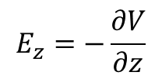
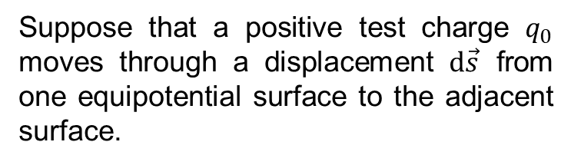



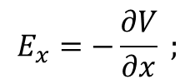
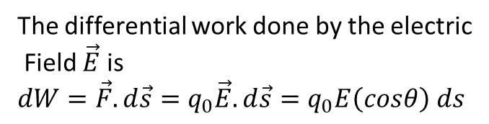
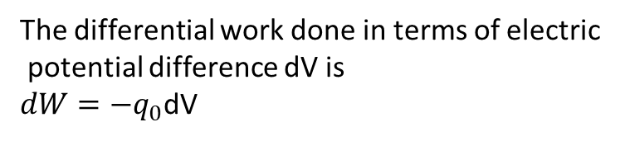
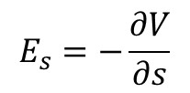
Calculating the Electric Field from the Electric Potential:
Suppose that a positive test charge $q_{0}$ moves through a displacement $d\vec{s}$ from one equipotential surface to the adjacent surface.
The differential work done in terms of electric
potential difference dV is
$dW=−q_{0}$dV
The differential work done by the electric
Field $\vec{E}$ is
$dW={\vec{F}.d\vec{s}=q}_{0}{\vec{E}.d\vec{s}=q}_{0}E\left(cosθ\right) ds$
Hence, we get
$−q_{0}dV=q_{0}E\left(cosθ\right) ds$
$E\left(cosθ\right)=−\frac{dV}{ds}$
$Since Ecos θ is the component of \vec{E}$ in the direction of $d\vec{s}$ , then
$$E_{s}=−\frac{∂V}{∂s}$$
If we take the s axis to be, in turn, the x, y, and z axes, we find that the x, y, and
z components of $\vec{E}$at any point are
$$E_{x}=−\frac{∂V}{∂x} ;$$
$E_{y}=−\frac{∂V}{∂y}$ ;
$$E_{z}=−\frac{∂V}{∂z}$$

Slide 5
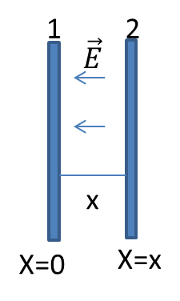



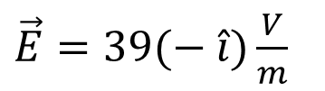
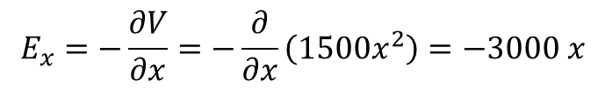
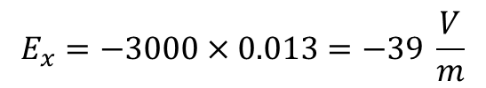

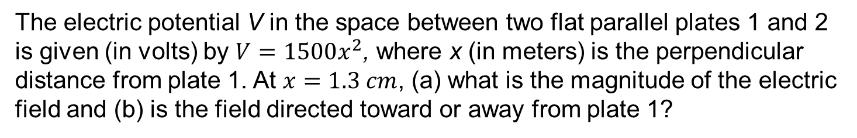


Problem 36 (Book Chapter 24)
The electric potential V in the space between two flat parallel plates 1 and 2 is given (in volts) by $V=1500x^{2}$, where x (in meters) is the perpendicular distance from plate 1. At $x=1.3 cm$, (a) what is the magnitude of the electric field and (b) is the field directed toward or away from plate 1?
(a) We have
Given
$$E_{x}=−\frac{∂V}{∂x}=−\frac{∂}{∂x}\left(1500x^{2}\right)=−3000 x$$
$$V=1500 x^{2}$$
$$E_{x}=−3000×0.013=−39 \frac{V}{m}$$
At x = 1.3 cm= 0.013 m ,
$$E=?$$
$\vec{E}=E_{x}\hat{i}=39(− \hat{i}$ )
The direction of electric field,
Magnitude of $\vec{E}$ is
$$\vec{E}=?$$
$E=39 \frac{V}{m}$
(b) The direction of electric field is toward plate 1, because
$\vec{E}=39(− \hat{i})\frac{V}{m}$

Slide 6

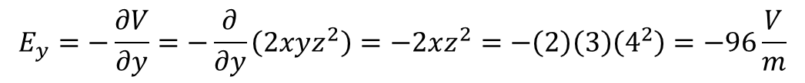

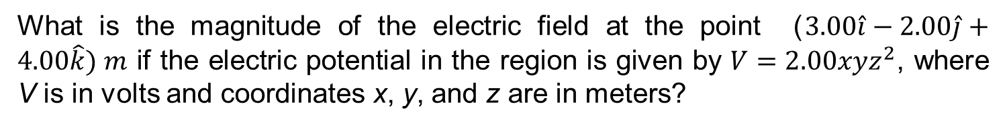

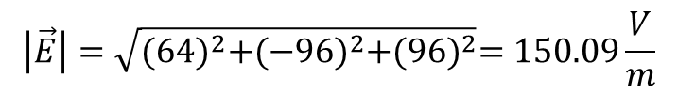
Problem 37 (Book Chapter 24)
What is the magnitude of the electric field at the point ($3.00\hat{i}−2.00\hat{j}+4.00\hat{k}) m$ if the electric potential in the region is given by $V=2.00xyz^{2}$, where V is in volts and coordinates x, y, and z are in meters?
Answer:
We know
$$E_{x}=−\frac{∂V}{∂x}=−\frac{∂}{∂x}\left(2xyz^{2}\right)=−2yz^{2}=−\left(2\right)\left(−2\right)\left(4^{2}\right)=64\frac{V}{m}$$
Given
$$E_{y}=−\frac{∂V}{∂y}=−\frac{∂}{∂y}\left(2xyz^{2}\right)=−2xz^{2}=−\left(2\right)\left(3\right)\left(4^{2}\right)=−96\frac{V}{m}$$
$$V=2xyz^{2}$$
And
$$E_{z}=−\frac{∂V}{∂z}=−\frac{∂}{∂z}\left(2xyz^{2}\right)=−4xyz=−\left(4\right)(3)\left(−2\right)\left(4\right)=96\frac{V}{m}$$
$\left(x,y,z\right)=(3,−2$, 4)
$$\left|\vec{E}\right|=?$$
$$\vec{E}=E_{x}\hat{i}+E_{y}\hat{j}+E_{z}\hat{k}=64\hat{i}−96\hat{j}+96\hat{k}$$
Therefore,
$$\left|\vec{E}\right|=\sqrt{{(64)}^{2}+{(−96)}^{2}+{(96)}^{2}}=150.09\frac{V}{m}$$

Slide 7
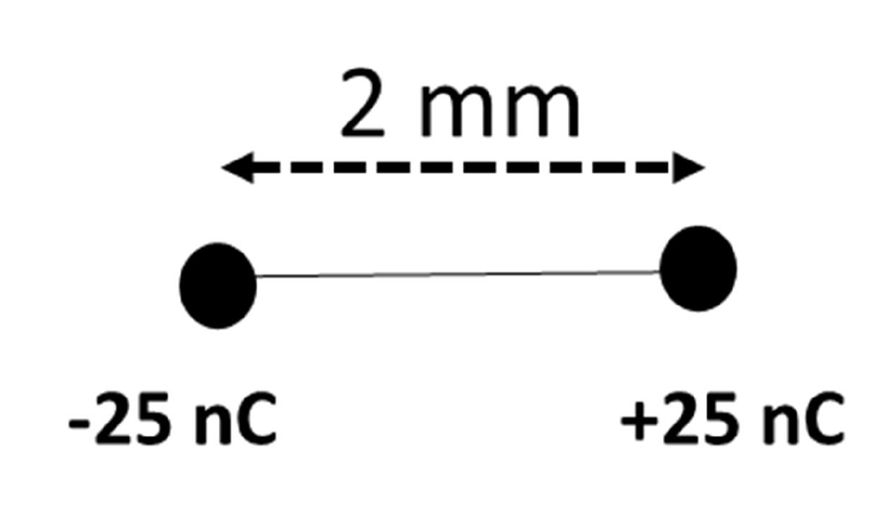
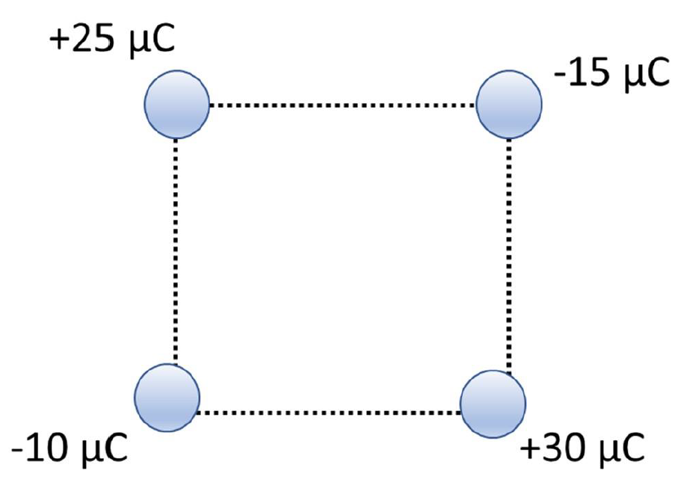
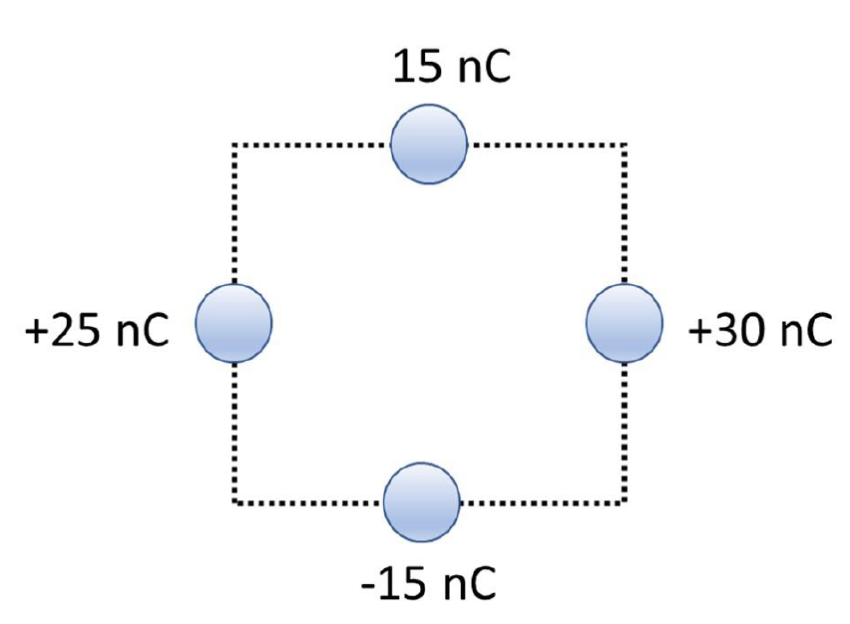
Do by yourself .
CALCULATE THE NET ELECTRIC POTENTIAL AT POINT P [ASSUME V= 0 AT INFINITY] (FIG. I)
CALCULATE THE NET ELECTRIC POTENTIAL AT POINT MIDWAY BETWEEN THE CHARGES [ASSUME V= 0 AT INFINITY]
CALCULATE THE NET ELECTRIC POTENTIAL AT THE CENTER OF THE SQUARE IF THE LENGTH OF EACH SIDE OF THE SQUARE IS 5.0 CM [ASSUME V= 0 AT INFINITY] .
CALCULATE THE NET ELECTRIC POTENTIAL AT THE CENTER OF THE SQUARE IF THE LENGTH OF EACH SIDE OF THE SQUARE IS 8.0 CM. [ASSUME V= 0 AT INFINITY]
Fig. I
Fig II
Fig. III
Fig. IV

Slide 8
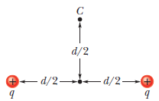
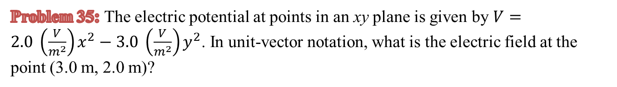
Let’s try !!!
Problem 35: The electric potential at points in an xy plane is given by $V=2.0 \left(\frac{V}{m^{2}}\right)x^{2}−3.0 \left(\frac{V}{m^{2}}\right)y^{2}$. In unit-vector notation, what is the electric field at the point (3.0 m, 2.0 m)?
Problem 88: Two charges q = 2.0 μC are fixed a distance d = 2.0 cm apart (adjacent Fig.). (a) With V = 0 at infinity, what is the electric potential at point C? (b) You bring a third charge q = 2.0 μC from infinity to C. How much work must you do? (c) What is the potential energy U of the three-charge configuration when the third charge is in place?

Slide 9

Thank You

